Slide 1
Java Functional Interfaces
Università di Modena e Reggio Emilia
Prof. Nicola Bicocchi (nicola.bicocchi@unimore.it)

Slide 2
Functional Programming
The imperative programming paradigm allows you to describe a program in terms of a sequence of statements that mutate state.
OOP Principles (value parametrization)
The functional programming paradigm describes a program by applying and composing functions. It is a declarative programming paradigm in which function definitions are trees of expressions that map values to other values.
Ability to pass functions (code) to other functions (behaviour parametrization)
No shared mutable data

Slide 3
Conflicting worlds?
Functional programs can be very terse and elegant, packing a lot of behaviour into very few lines of code. Functional programmers will make the case that in a multicore world, you need to avoid mutable state in order to scale out your programs.
Object-oriented programmers will retort that in actual business environments object-oriented programming scales out well in terms of developers, and as an industry, we know how to do it. Software engineering requires us to match technical solutions to business problems.

Slide 4
Conflicting worlds?
A typical problem in 1991: The Berlin wall is collapsing. The US will guarantee peace and harmony for centuries! Model my small company, employees, departments, salaries!
public class Employee {
private String name;
private String lastname;
public Employee(String name, String lastname) {
this.name = name;
this.lastname = lastname;
}
@Override
public String toString() {
return "Employee{" +
"name='" + name + '\'' +
", lastname='" + lastname + '}';
}
}
A typical problem in 2021: my company now has 178000 employees but it is struggling against Chinese competition. Analyse my 20TB dataset for finding lazy people!
List<Employee> l = employees
.stream()
.filter(c -> c.getVacations() > 5) .collect(Collectors.toList());

Slide 5
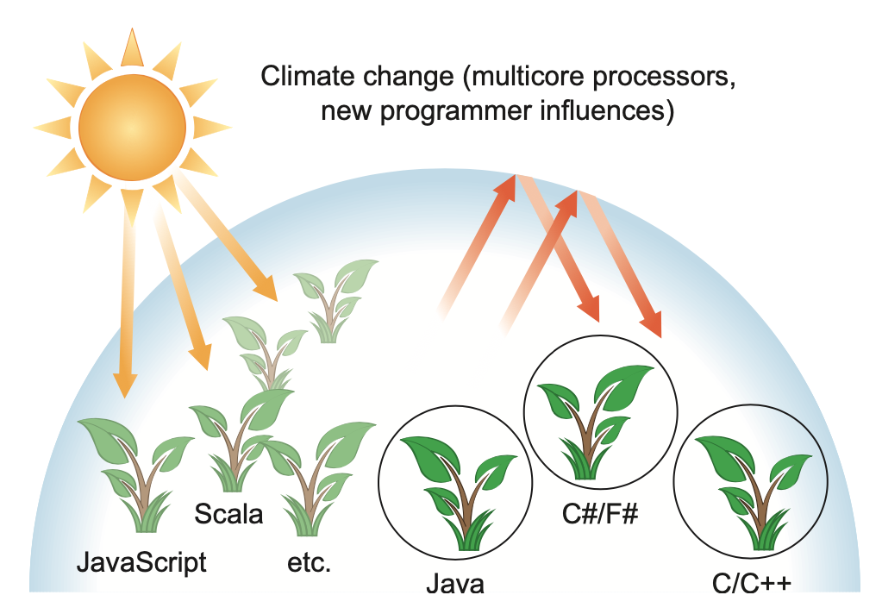
Why is Java still changing?
The rise of big-data, and affordable multi-core architectures made functional programming concepts popular again.
A number of languages (Java, Python, Scala) are introducing ways for better supporting functional programming.
Haskell is a recent purely functional language.
Languages need to evolve to track changing hardware or programmers expectations. Otherwise, they die (COBOL, LISP, …)

Slide 6
Filtering students
Suppose you have a class Student with a method getAverage() and a collection students holding a list of Student references.
You want to select all the students with a specific average.
public static List<Student> filterStudentsByGrade(
List<Student> students, double average) {
List<Student> result = new ArrayList<>(); for (Student s : students) { if (s.getAverage() == average) { result.add(s); } } return result; }

Slide 7
Different filter, different code??
Now you want to select all the students with an average comprised within a given range.
Breaks the DRY (don’t repeat yourself) principle of software engineering. These two methods vary only in one line: the highlighted condition inside the if construct.
public static List<Student> filterStudentsByGradeRange(
List<Student> students, int low, int high) {
List<Student> result = new ArrayList<>();
for (Student s : students) {
if (s.getAverage() > low && s.getAverage() < high) {
result.add(s);
}
}
return result;
}

Slide 8
Interfaces help us! ☺
We can define a StudentPredicate interface encapsulating the selection strategy. Different classes can then implement different strategies.
interface StudentPredicate {
boolean test(Student s);
}
class StudentBadPredicate implements StudentPredicate {
public boolean test(Student s) {
return s.getAverage() <= 20;
}
}
class StudentGoodPredicate implements StudentPredicate { public boolean test(Student p) { return s.getAverage() >= 26; } }

Slide 9
Interfaces help us! ☺
This code is much more flexible than our first attempt, and at the same time it’s easy to read and to use!
Behaviour parameterization is great because it enables you to separate the logic of iterating the collection to filter and the behaviour to apply on each element of that collection.
public static List<Student> filterStudents(
List<Student> students, StudentPredicate tester) {
List<Student> result = new ArrayList<>();
for (Student s : students) {
if (tester.test(s)) {
result.add(s);
}
}
return result;
}
/* main */
goodStudents = filterStudents(students, new StudentGoodPredicate());
badStudents = filterStudents(students, new StudentBadPredicate());

Slide 10
Interfaces are verbose! ☹
However, when you want to pass new behaviour to your filterStudent method, you’re forced to declare several classes that implement the StudentPredicate interface and then instantiate several StudentPredicate objects that you allocate only once. There’s a lot of verbosity involved and it’s a time-consuming process! Verbosity in general is bad; it discourages the use of a language feature because it takes a long time to write and maintain.
interface StudentPredicate {
boolean test(Student s);
}
class StudentBadPredicate implements StudentPredicate {
public boolean test(Student s) {
return s.getAverage() >= 20 && s.getAverage() <= 24;
}
}
class StudentGoodPredicate implements StudentPredicate { public boolean test(Student s) { return s.getAverage() >= 20 && s.getAverage() <= 24; } }

Slide 11
Anonymous classes. Better.
public static List<Student> filterStudents(
List<Student> students, StudentPredicate tester) {
List<Student> result = new ArrayList<>();
for (Student s : students) {
if (tester.test(s)) {
result.add(s);
}
}
return result;
}
result = filterStudents(l, new StudentPredicate() { @Override public boolean test(Student p) { return p.getAverage() >= 20 && p.getAverage() <= 24; } });
Anonymous classes enable you to make your code more concise.
They enable you to declare and instantiate a class at the same time.
They are like local classes except that they do not have a name.
Use them if you need to use a local class only once. In short, they allow you to create ad hoc implementations.

Slide 12
Lambda expressions
A lambda expression can be understood as a concise representation of an anonymous function that can be passed around. It doesn’t have a name, but it has a list of parameters, a body, a return type, and also possibly a list of exceptions that can be thrown. That’s one big definition; let’s break it down:
Anonymous—We say anonymous because it doesn’t have an explicit name like a method would normally have; less to write and think about!
Function—We say function because a lambda isn’t associated with a particular class like a method is. But like a method, a lambda has a list of parameters, a body, a return type, and a possible list of exceptions that can be thrown.
Passed around—A lambda expression can be passed as argument to a method or stored in a variable.
Concise—You don’t need to write a lot of boilerplate like you do for anonymous classes.

Slide 13
Lambda expressions
This syntax was chosen by the Java language designers because it was well received in other languages, such as C#, Scala, JavaScript. The basic syntax of a lambda is either (referred to as an expression-style lambda)
(parameters) -> expression
or (note the curly braces for statements, this lambda is often called a block-style lambda)
(parameters) -> { statements; }

Slide 14
Lambda expressions
1. () -> {}
2. () -> "Raoul"
3. () -> { return "Mario"; }
/* wrong! not an expression! */
4. (Integer i) -> return "Alan" + i;
/* wrong! not a statement! */
5. (String s) -> { "Iron Man"; }

Slide 15
Lambda expressions
1. A boolean expression
(List<String> list) -> list.isEmpty()
2. Creating objects
() -> new Apple(10)
3. Consuming from an object
(Apple a) -> { System.out.println(a.getWeight()); }
4. Select/extract from an object
(String s) -> s.length()
5. Combine two values
(int a, int b) -> a * b
6. Compare two objects
(Apple a1, Apple a2) -> a1.getWeight().compareTo(a2.getWeight())

Slide 16
Functional interfaces
Functional interfaces or interfaces defining only one function (one method) are ideal candidates for making use of lambda expressions.
Instead of using anonymous classes (still verbose!), lambda expressions can be used for providing the implementation of their single method!
public interface Comparator<T> {
int compare(T o1, T o2);
}
public interface Runnable {
void run();
}
public interface ActionListener extends EventListener {
void actionPerformed(ActionEvent e);
}
public interface Callable<V> {
V call() throws Exception;
}

Slide 17
Lambda expressions
Before (with anonymous classes):
Comparator<Apple> byWeight =
new Comparator<Apple>() {
public int compare(Apple a1, Apple a2){
return a1.getWeight().compareTo(a2.getWeight());
}
};
After (with lambda expressions):
Comparator<Apple> byWeight =
(Apple a1, Apple a2) -> a1.getWeight().compareTo(a2.getWeight());

Slide 18
Lambda expressions. Much better!
interface StudentPredicate {
boolean test(Student p);
}
public static List<Student> filterStudents(
List<Student> students, StudentPredicate tester) {
List<Student> result = new ArrayList<>();
for (Student s : students) {
if (tester.test(s)) {
result.add(s);
}
}
return result;
}
result = filterStudents(
students,
(Student s) -> s.getAverage() >= 20 && s.getAverage() <= 24);

Slide 19
Lambda expressions and Generics. Pro level!
interface Predicate<T> {
boolean test(T t);
}
public static <T> List<T> filter(List<T> l, Predicate<T> tester) {
List<T> result = new ArrayList<>();
for (T element : l) {
if (tester.test(element)) {
result.add(element);
}
}
return result;
}
result = filter(
students,
(Student s) -> s.getAverage() >= 20 && s.getAverage() <= 24);

Slide 20
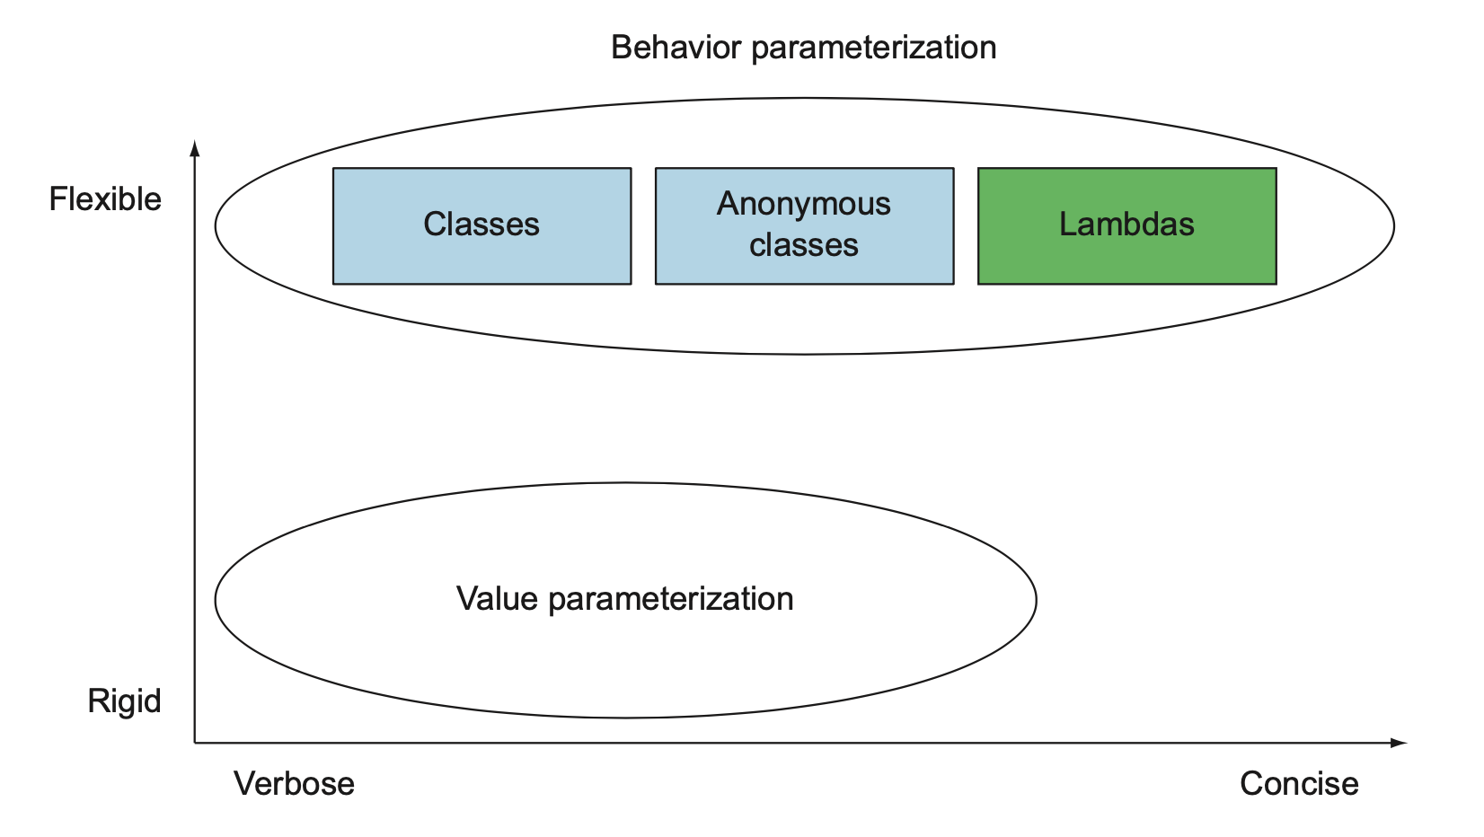
Behavior parametrization

Slide 21
Functional Interfaces

Slide 22
Functional interfaces
What can you do with functional interfaces? Lambda expressions let you provide the implementation of the abstract method of a functional interface directly inline and treat the whole expression as an instance of a functional interface (more technically speaking, an instance of a concrete implementation of the functional interface)

Slide 23
An example: Runnable
public static void process(Runnable r) {
r.run();
}
/* main method */
Runnable r1 = new Runnable() {
public void run() {
System.out.println("Hello World 1");
}};
Runnable r2 = () -> System.out.println("Hello World 2");
process(r1);
process(r2);
process(() -> System.out.println("Hello World 3"));

Slide 24
java.util.function.Predicate<T>
The java.util.function.Predicate<T> interface defines an abstract method named test that accepts an object of generic type T and returns a boolean.
It’s exactly the same one that you created earlier, but it’s available out of the box!
You might want to use this interface when you need to represent a boolean expression that uses an object of type T.

Slide 25
java.util.function.Predicate<T>
The java.util.function.Predicate<T> interface defines an abstract method named test that accepts an object of generic type T and returns a boolean.
It’s exactly the same one that you created earlier, but it’s available out of the box!
You might want to use this interface when you need to represent a boolean expression that uses an object of type T.
@FunctionalInterface
public interface Predicate<T> {
boolean test(T t);
}

Slide 26
java.util.function.Predicate<T>
public static <T> List<T> processPredicate(
List<T> items,
Predicate<T> tester) { List<T> result = new ArrayList<>(); for (T item : items) { if (tester.test(item)) { result.add(item); } } return result; }
/* main */
results = processPredicate(
students,
(Student s) -> s.getAverage() >= 20 && s.getAverage() <= 24
);

Slide 27
java.util.function.Consumer<T>
The java.util.function.Consumer<T> interface defines an abstract method named accept that takes an object of generic type T and returns no result (void).
You might use this interface when you need to access an object of type T and perform some operations on it.
@FunctionalInterface
public interface Consumer<T> {
void accept(T t);
}

Slide 28
java.util.function.Consumer<T>
public static <T> List<T> processPredicateConsumer(List<T> items, Predicate<T> tester, Consumer<T> consumer) { List<T> result = new ArrayList<>(); for (T item : items) { if (tester.test(item)) { consumer.accept(item); result.add(item); } } return result; }
/* main */
results = processPredicateConsumer( students, (Student s) -> s.getAverage() >= 20 && s.getAverage() <= 24, (Student s) -> System.out.println(s) );

Slide 29
java.util.function.Function<T, R>
The java.util.function.Function<T, R> interface defines an abstract method named apply that takes an object of generic type T as input and returns an object of generic type R.
You might use this interface when you need to define a lambda that maps information from an input object to an output (for example, extracting the weight of an apple or mapping a string to its length).
@FunctionalInterface
public interface Function<T, R> {
R apply(T t);
}

Slide 30
java.util.function.Function<T, R>
public static <X, Y> List<X> processPredicateConsumerFunction(List<X> items, Predicate<X> tester, Function<X, Y> mapper, Consumer<Y> consumer) { List<X> result = new ArrayList<>(); for (X item : items) { if (tester.test(item)) { Y output = mapper.apply(item); consumer.accept(output); result.add(item); } } return result; }
/* main */
results = processPredicateConsumerFunction(
students,
(Student s) -> s.getAverage() >= 20 && s.getAverage() <= 24,
(Student s) -> s.getName(),
(String s) -> System.out.println(s)
);

Slide 31
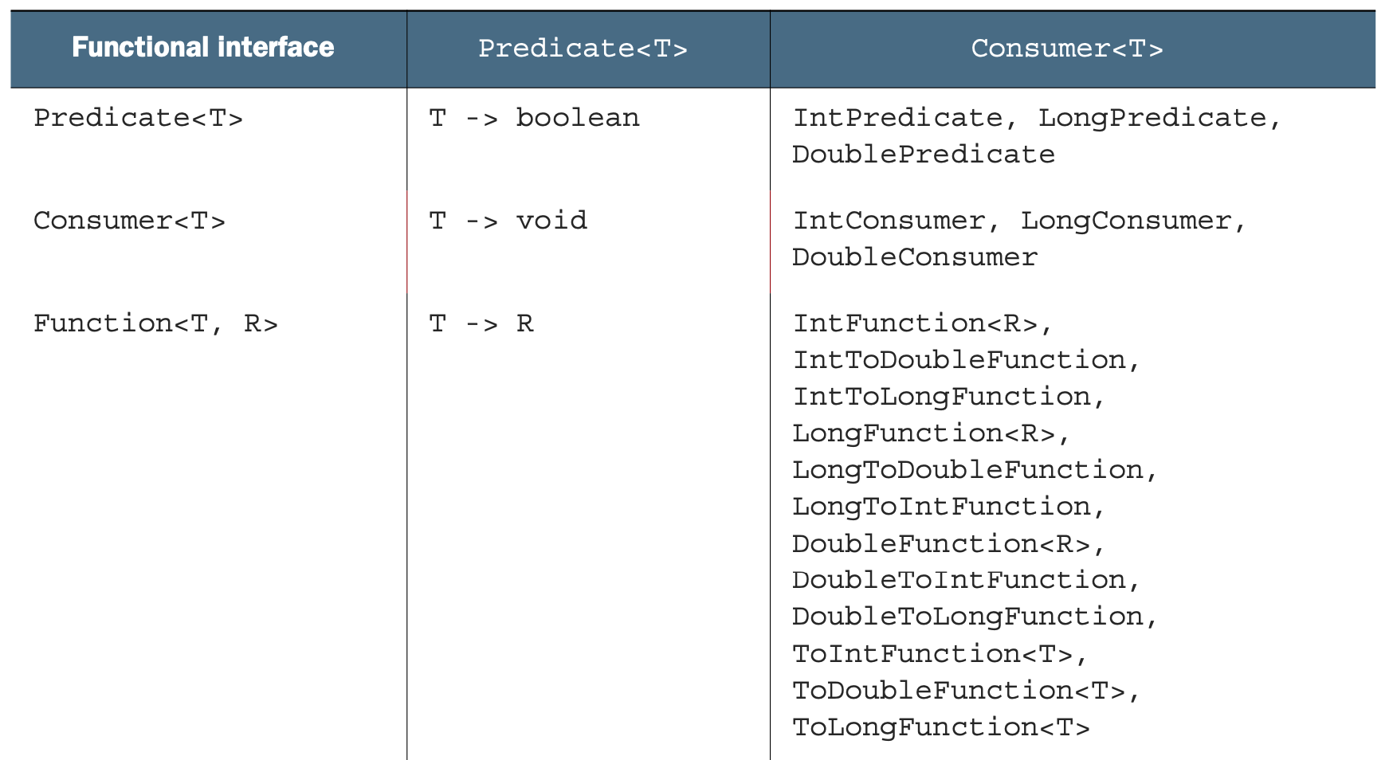
Key Functional Interfaces

Slide 32
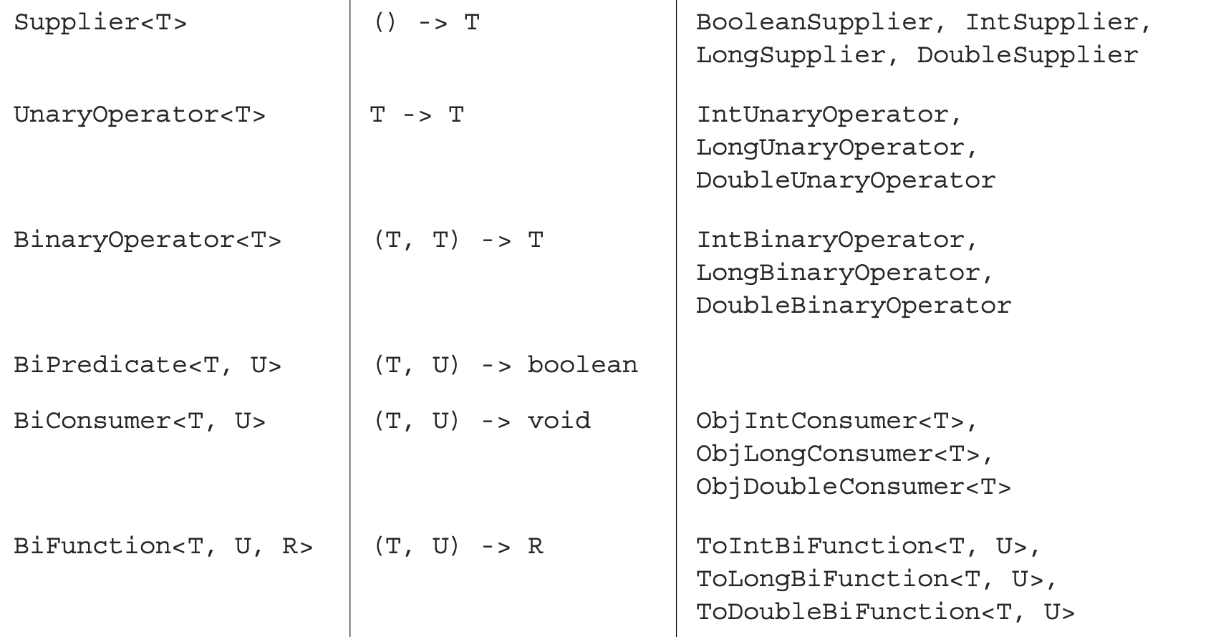
Key Functional Interfaces

Slide 33
Method references
Method references let you reuse existing method definitions and pass them like lambdas. In some cases they appear more readable and feel more natural than using lambda expressions.
Method references can be seen as shorthand for lambdas calling only a specific method. The basic idea is that if a lambda represents “call this method directly,” it’s best to refer to the method by name rather than by a description of how to call it.

Slide 34
Method references
public static <X, Y> List<X> processPredicateConsumerFunction(List<X> items, Predicate<X> tester, Function<X, Y> mapper, Consumer<Y> consumer) { List<X> result = new ArrayList<>(); for (X item : items) { if (tester.test(item)) { Y output = mapper.apply(item); consumer.accept(output); result.add(item); } } return result; }
/* main */
results = processPredicateConsumerFunction(
students,
(Student s) -> s.getAverage() >= 20 && s.getAverage() <= 24,
Student::getName,
System.out::println);

Slide 35
Wisdom Pills
I have two kinds of problems, the urgent and the important. The urgent are not important, and the important are never urgent -- President Dwight D. Eisenhower
It is the responsibility of the software development team to assert the importance of architecture over the urgency of features -- Clean Code, Robert C. Martin

